Slide 1



Fault-Tolerant Distributed File Systems
PRESENTED BY
Sanjay.R (192211425)
Ranjith.R (192211667)
GUIDED BY
S.Jayanthi
Information security
Notes:
1

Slide 2
INTRODUCTION
Distributed file systems (DFS) are a critical component of modern computing infrastructure, enabling data sharing and collaboration across geographically dispersed systems. In an increasingly interconnected world, the need for reliable and robust storage solutions that can withstand failures is paramount. Fault tolerance is a key characteristic of DFS, ensuring data availability and integrity even in the face of hardware or software failures. This presentation will delve into the intricacies of fault-tolerant DFS, exploring its architecture, mechanisms, and challenges.
Notes:
3

Slide 3

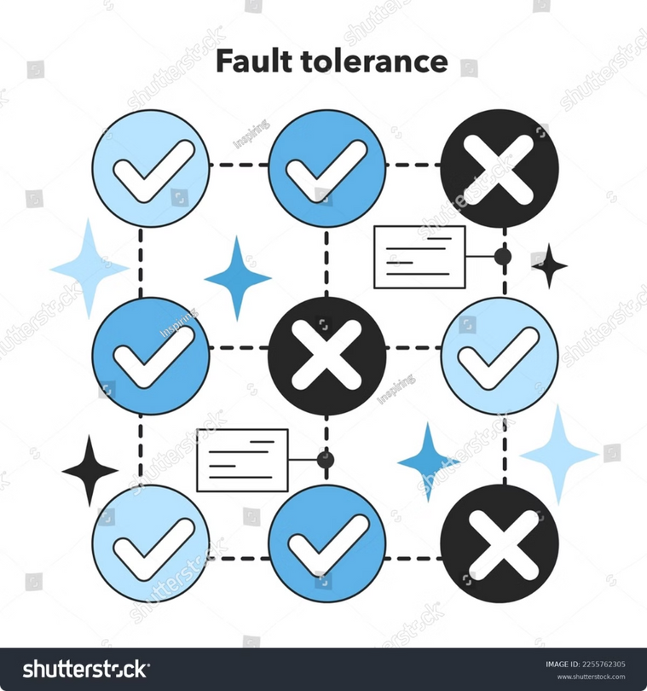

What is Fault Tolerance?
Fault tolerance is a system's ability to maintain its functionality and operation even when components fail. This is particularly crucial for DFS where data is distributed across multiple servers. In a fault-tolerant DFS, the system is designed to detect and handle failures, preventing data loss and ensuring continued access.
1
Redundancy
2
Error Detection
Fault tolerance is achieved through redundancy, where critical components are replicated to provide backup in case of failure.
The system employs mechanisms to detect errors, such as checksums or parity checks, allowing for quick identification and mitigation of faulty data.
3
Recovery Mechanisms
Fault-tolerant DFS incorporates mechanisms to recover from failures, including data replication, automatic failover, and repair processes.
Notes:
2

Slide 4
DFS Architecture
The architecture of a fault-tolerant DFS is designed to ensure data availability and consistency in the presence of failures. Typically, it comprises multiple servers interconnected in a network. Data is distributed across these servers, with replication strategies employed to ensure redundancy.
Data Nodes
Metadata Server
Client Nodes
Servers responsible for storing and managing data blocks. They typically handle data replication, read/write requests, and error detection.
Centralized server responsible for managing metadata, including file names, locations, and access permissions. It ensures consistency of metadata across the system.
Clients interact with the DFS through these nodes, accessing data and managing files. They communicate with both data nodes and the metadata server.
Notes:
3

Slide 5


Data Replication and Redundancy
Replication is a cornerstone of fault tolerance in DFS. It involves creating multiple copies of data on different servers. This redundancy ensures that if one server fails, the data is still accessible from other copies.
Mirroring
RAID
Every data block is replicated on a secondary server. Provides high availability but can be expensive due to the high storage overhead.
Uses a combination of data striping and parity information to distribute data across multiple disks. Provides a balance between performance and redundancy.
Erasure Coding
Uses mathematical techniques to create encoded data blocks that can reconstruct the original data from a subset of these blocks.
Notes:
4

Slide 6

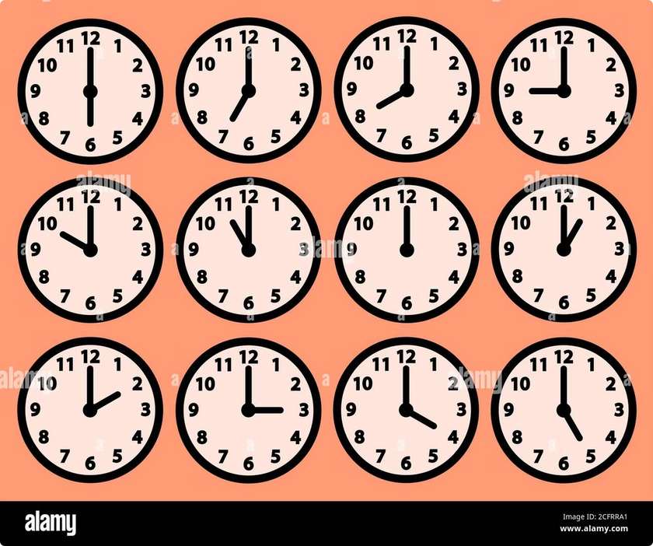
Consistency Models
Consistency models define how data updates are propagated across different nodes in a DFS, ensuring that all clients see a consistent view of the data. Different consistency models offer varying levels of performance and data consistency.
1
Strong Consistency
All clients see the same consistent view of the data at any given time. Provides high data integrity but can impact performance.
2
Sequential Consistency
Operations are applied in a specific order across all nodes, preserving the order of updates. Balances performance and data consistency.
3
Eventual Consistency
Data updates are eventually propagated across all nodes, with the system converging towards a consistent state. Offers high performance but lower data consistency.
Notes:
5

Slide 7





Fault Detection and Recovery
Fault-tolerant DFS employ mechanisms to detect and recover from failures. These mechanisms ensure that the system remains operational and data remains available in the face of failures.
Heartbeats
Periodic messages exchanged between nodes to verify their availability. If a node fails to respond, it is considered down.
Timeout Mechanisms
If a node doesn't respond within a specified time, it is considered unresponsive, triggering fault detection and recovery procedures.
Redundant Communication Paths
Data is replicated across multiple nodes, and communication paths are designed to bypass faulty nodes, ensuring message delivery.
Notes:
6

Slide 8


Consensus Algorithms
Consensus algorithms are essential in fault-tolerant DFS to ensure that all nodes agree on the state of the system and data, particularly during failures. These algorithms enable a distributed decision-making process, ensuring consistency and data integrity.
Paxos
A complex algorithm that allows for a distributed consensus among nodes, even if some nodes fail.
Raft
A simpler and more practical alternative to Paxos, offering a more streamlined and easier-to-understand consensus mechanism.
Byzantine Fault Tolerance
Handles scenarios where some nodes may behave maliciously or provide inconsistent information. This is particularly crucial in distributed systems.
Notes:
7

Slide 9





Challenges in Fault-Tolerant DFS
Building a fault-tolerant DFS presents several challenges, demanding careful design and implementation. These challenges are intricately intertwined with the complexities of distributed systems and the need for robustness and reliability.
Complexity
The architecture and algorithms involved in fault tolerance can be complex, requiring extensive testing and debugging.
Performance Tradeoffs
Fault tolerance often comes at the cost of performance, as redundancy and recovery mechanisms can increase latency.
Cost
Replication and redundancy require additional storage and computational resources, increasing the overall cost of the system.
Notes:
8

Slide 10
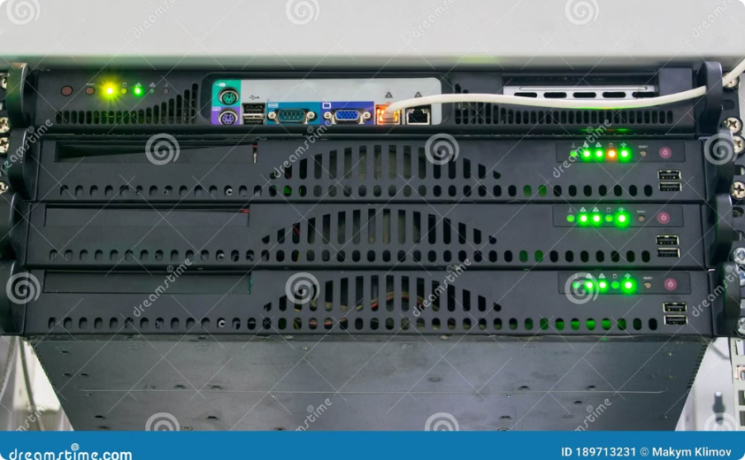
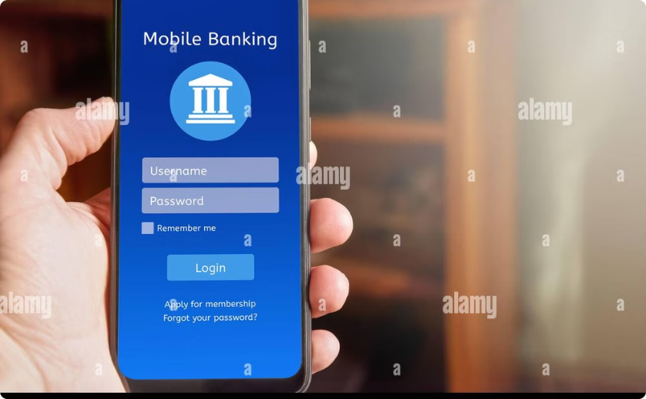
Applications of Fault-Tolerant DFS
Fault-tolerant DFS find applications in various domains, ranging from cloud computing and data centers to distributed databases and high-performance computing. Their ability to handle failures makes them essential for ensuring data integrity and availability.
Cloud Storage
Distributed Databases
Fault-tolerant DFS is at the heart of cloud storage solutions, enabling scalable and reliable storage for large datasets.
Distributed databases rely on fault-tolerant DFS to ensure data consistency and availability across multiple nodes.
Notes:
9

Slide 11
PSUDO CODE
DEFINE MAX_NODES AS 3
DEFINE MAX_FILE_SIZE AS 100
STRUCT File
STRING fileName[50]
STRING fileData[MAX_FILE_SIZE]
INTEGER nodeID
STRUCT Node
INTEGER nodeID
ARRAY of File files[MAX_FILE_SIZE]
INTEGER fileCount
INITIALIZE ARRAY of Node nodes[MAX_NODES]
// FUNCTION to initialize nodes
FUNCTION initializeNodes()
FOR i FROM 0 TO MAX_NODES - 1 DO
SET nodes[i].nodeID = i + 1
SET nodes[i].fileCount = 0
END FOR
END FUNCTION
// FUNCTION to replicate file across all nodes
FUNCTION replicateFile(STRING fileName, STRING data)
FOR i FROM 0 TO MAX_NODES - 1 DO
SET nodes[i].files[nodes[i].fileCount].fileName = fileName
SET nodes[i].files[nodes[i].fileCount].fileData = data
SET nodes[i].files[nodes[i].fileCount].nodeID = nodes[i].nodeID
INCREMENT nodes[i].fileCount
END FOR
PRINT "File 'fileName' replicated successfully across all nodes."
END FUNCTION
// FUNCTION to read file from a specific node
FUNCTION readFileFromNode(STRING fileName, INTEGER nodeID)
FOR i FROM 0 TO nodes[nodeID - 1].fileCount - 1 DO
IF nodes[nodeID - 1].files[i].fileName EQUALS fileName THEN
PRINT "Reading file 'fileName' from Node nodeID: nodes[nodeID - 1].files[i].fileData"
RETURN
END IF
END FOR
PRINT "File 'fileName' not found on Node nodeID."
END FUNCTION
// MAIN FUNCTION
FUNCTION main()
CALL initializeNodes()
STRING fileName[50]
STRING fileData[MAX_FILE_SIZE]
INTEGER choice, nodeID
WHILE TRUE DO
PRINT "\n1. Replicate File\n2. Read File from Node\n3. Exit\nEnter your choice: "
SCAN choice
SWITCH choice DO
CASE 1:
PRINT "Enter file name: "
SCAN fileName
PRINT "Enter file data: "
SCAN fileData
CALL replicateFile(fileName, fileData)
BREAK
CASE 2:
PRINT "Enter file name to read: "
SCAN fileName
PRINT "Enter node ID to read from (1 to MAX_NODES): "
SCAN nodeID
IF nodeID < 1 OR nodeID > MAX_NODES THEN
PRINT "Invalid node ID. Please try again."
ELSE
CALL readFileFromNode(fileName, nodeID)
END IF
BREAK
CASE 3:
PRINT "Exiting program."
EXIT
DEFAULT:
PRINT "Invalid choice. Please try again."
END SWITCH
END WHILE
END FUNCTION
Notes:
10

Slide 12
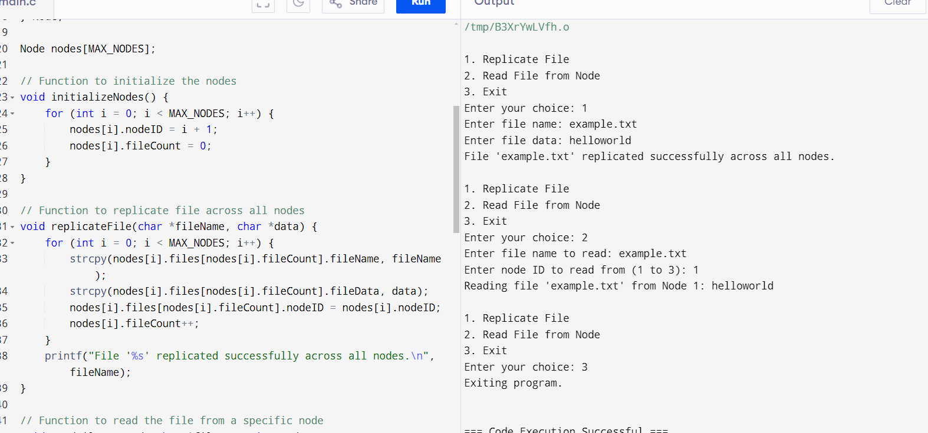
OUTPUT
Notes:
10

Slide 13

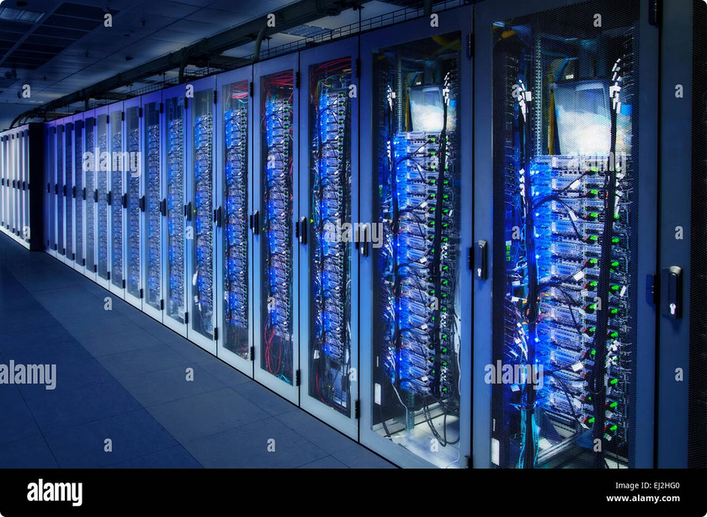
Conclusion
Fault-tolerant distributed file systems are crucial components of modern computing infrastructure, ensuring data availability and integrity in the face of failures. They employ various techniques, including redundancy, consistency models, and consensus algorithms, to achieve resilience and reliability.
While building a fault-tolerant DFS presents challenges, the benefits in terms of data availability, performance, and scalability are significant. As computing systems continue to evolve and become more complex, the importance of fault tolerance in DFS will only continue to grow, ensuring that our data remains safe and accessible in an increasingly dynamic and unpredictable world.
Notes:
10

